Slide 1
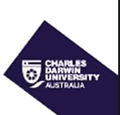
CHARLES DARWIN
UNIVERSITY
Sydney Group 19
Assessment 2
Group members
Name | Student ID
Krystal Bhandari | S401359
Shreya Khatri | S401646
Md Abid Hossain Fahim | S401478
Saykot Sarkar | S401744
S226 HIT140
Foundations of Data Science
Notes:
Charles Darwin University. S226 HIT140 Foundations of Data Science. Assessment 2. Sydney Group 19. Members: Krystal Bhandari, S401359; Shreya Khatri, S401646; Md Abid Hossain Fahim, S401478; Saykot Sarkar, S401744. Names and IDs supplied by the user. CDU logo and purple-and-gold design follow the supplied reference.

Slide 2
ANALYTIC QUESTION FORMULATION
1
Why this question?
“Among teams that scored at least one goal, does the average percentage of team goals scored by a single leading scorer differ from 50%?”
What I measured
Leading scorer share (%) = 100 × leading scorer goals ÷ team GF.
What I compared
The average team percentage against 50%, meaning one player scores half the goals.
Why it matters
It measures scoring concentration, a distinct focus from points and defensive efficiency.
MD Abid Hossain Fahim s401478 S226 HIT140 Foundation of Data Science Sydney Group 19

Slide 3
DATA WRANGLING
2
Preparing the team scoring data
1
2
3
Checked the raw data
Extracted scorer goals
Calculated the percentage
Cleaned whitespace and numeric types in Python.
Verified MP = W + D + L, GD = GF − GA, and Pts = 3W + D.
All 48 rows passed these checks.
Parsed the final number in “Top Team Scorer”.
For tied scorers, used the shared individual tally.
Did not multiply by the number of names.
Share = 100 × scorer goals ÷ GF.
Excluded Panama: GF = 0 gives an undefined 0/0 share.
Retained 47 eligible teams.
MD Abid Hossain Fahim s401478 S226 HIT140 Foundation of Data Science Sydney Group 19

Slide 4
DATA PREPARATION AND SAMPLING
3
Population vs. sample
FINITE SAMPLING FRAME
SIMPLE RANDOM SAMPLE
47
36
Goal-scoring teams in the supplied file.
The original dataset contains 48 teams.
Without replacement, using seed 401478.
Each eligible team has equal selection probability.
All eligible records are available. Sampling demonstrates the assessment’s required technique.
Each team receives equal weight.
Sample size is practical, not a power guarantee.
MD Abid Hossain Fahim s401478 S226 HIT140 Foundation of Data Science Sydney Group 19

Slide 5
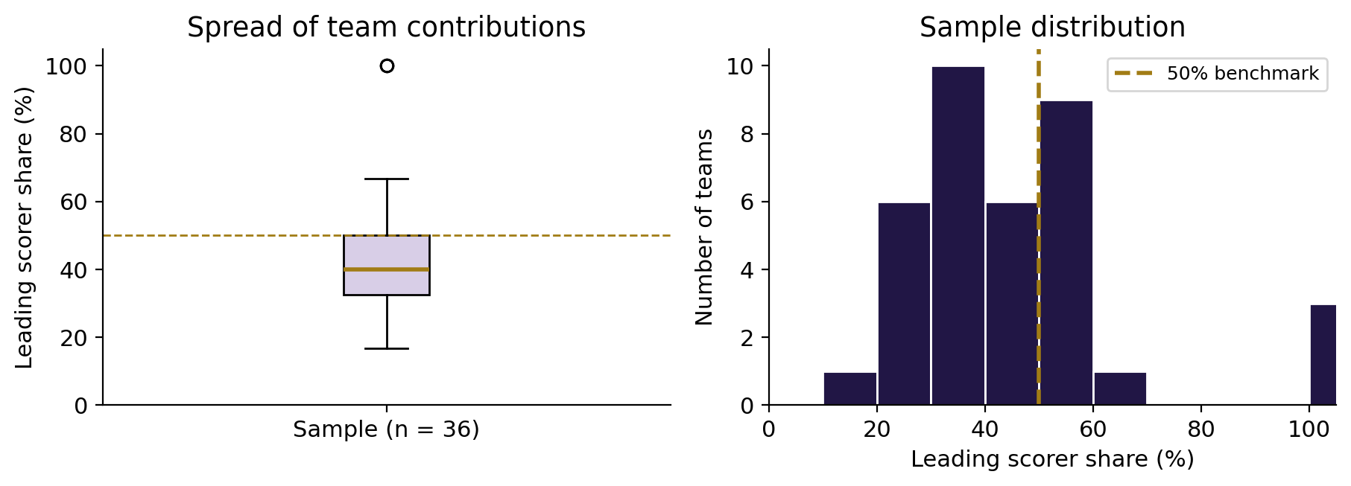
DESCRIPTIVE STATISTICS
4
Leading scorers contributed 43.35% on average
SAMPLE MEAN
43.35%
Leading scorer share
SPREAD AND CENTRE
Median: 40.00%
SD: 20.22 percentage points
Range: 16.67% to 100.00%
Q1 = 32.50% Q3 = 50.00% IQR = 17.50 percentage points
The distribution has a right tail. A 100% share is valid when one player scored all the team’s goals.
MD Abid Hossain Fahim s401478 S226 HIT140 Foundation of Data Science Sydney Group 19

Slide 6
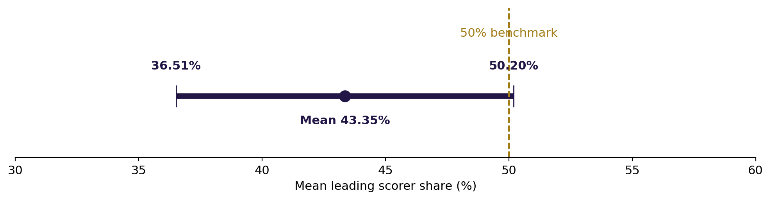
CONFIDENCE INTERVAL
5
Estimating the mean leading scorer share
95% standard t confidence interval for the mean team percentage
36.51% to 50.20% includes the 50% benchmark.
The interval concerns the mean, not 95% of individual teams.
CI = mean ± t* × s/√n. SE = 3.3706 percentage points, df = 35. No finite-population correction.
MD Abid Hossain Fahim s401478 S226 HIT140 Foundation of Data Science Sydney Group 19

Slide 7
ONE-SAMPLE T-TEST
6
Does the average differ from 50%?
HYPOTHESES
T-STATISTIC
P-VALUE
EFFECT SIZE
μ₀ = 50%
−1.9721
0.05654
d = −0.329
H₀: μ = 50%
H₁: μ ≠ 50%
Two-sided, α = 0.05
t = (mean − 50) / SE
Degrees of freedom: 35
Above the preselected 0.05 significance level.
Mean difference:
−6.65 percentage points
Relative to the benchmark.
Decision: fail to reject H₀
Under the standard t-test assumptions, the sample provides insufficient evidence that the mean differs from 50% at the 5% level.
This does not prove equality. Levene’s test is unnecessary for a one-sample t-test.
MD Abid Hossain Fahim s401478 S226 HIT140 Foundation of Data Science Sydney Group 19

Slide 8
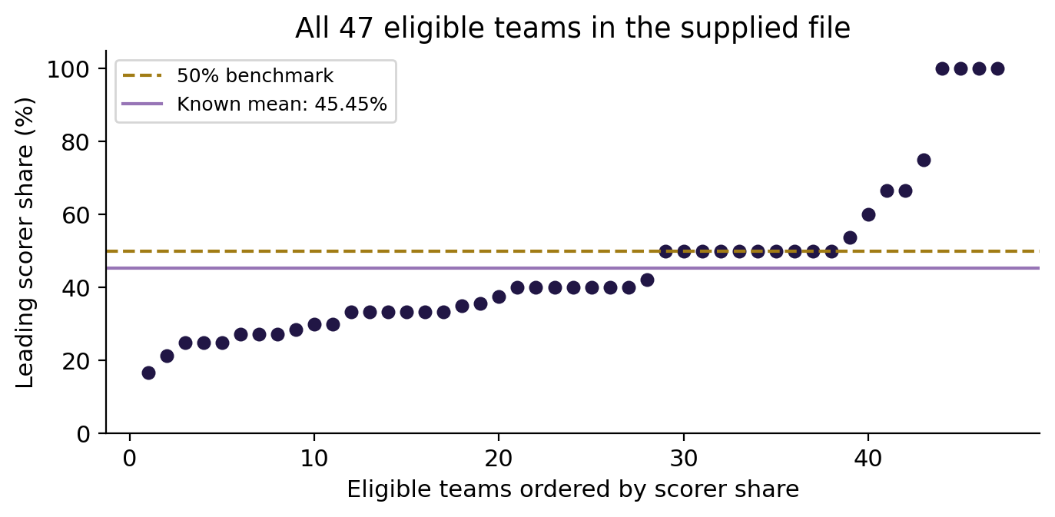
CONCLUSION
7
No clear model-based difference at 5%
The sample mean is 43.35%. The standard t-test gives p = 0.05654.
The known mean for all 47 eligible teams is 45.45%, descriptively below 50%.
Skewness, the finite frame and shared opponents limit the inference.
The full-frame mean is already known. The t-test illustrates a working model and cannot establish causation or generalise reliably to other tournaments.
MD Abid Hossain Fahim s401478 S226 HIT140 Foundation of Data Science Sydney Group 19

